Slide 1

Agentic coding
Cracking the MCP Mysteries
Alex Drenea Cloud @ Microsoft

Slide 2
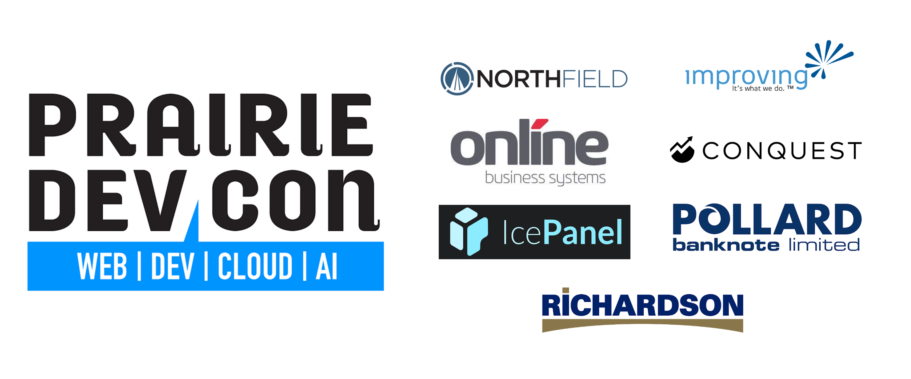

Slide 3

Disclaimer
This presentation was last updated on Sep 15th, 2025 - so it may contain outdated information.

Slide 4


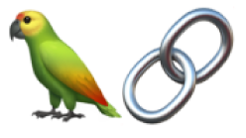
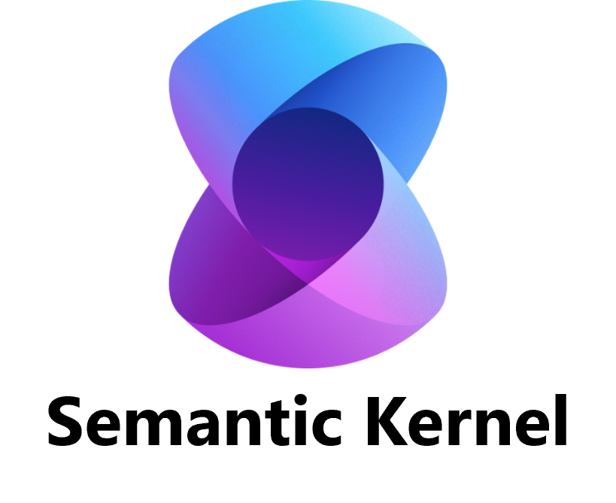
Agents and Agenting development
“New Gen” chatbots
Agentic AI
2023-2024
2022
2024-2025
Early agentic systems
Notes:
In late 2022, the launch of ChatGPT marked a turning point. For the first time, a simple but powerful chatbot captured global attention, showing how a new type of AI could understand and produce human-like language at scale. This became known as Generative AI and it sparked the current era AI revolution.
Soon after, we saw the early stages of agentic systems emerge through frameworks like LangChain, Semantic Kernel, and RAG-based architectures, which introduced memory, tool use, and context management—laying the foundation for true autonomy.
Fast forward to today, and we’re in the era of agentic AI: systems that don’t just respond, but plan, reason, and act across multiple steps. Unlike traditional assistants, these agents can interpret goals, use tools, and execute tasks without constant human micromanagement. They maintain context, collaborate with other agents, and adapt dynamically—moving from reactive helpers to proactive teammates.”**
It was on this foundations that GitHub, among others, launched the first true developer agent – GitHub Copilot has been around a while, but the new “Agent mode” was a game changer. Gone are the days where your AI is just a glorified IntelliSense, and here are the days where your AI copilot can write significant portions of your features, across multiple files, in one go.
Why does this matter? Because this shift is more than incremental—it’s transformative. According to Capgemini, AI agents are among the fastest-emerging tech trends, projected to create $450 billion in economic value by 2028 through efficiency and revenue gains. Already, 14% of organizations have deployed them at scale, and nearly a quarter are running pilots. https://www.capgemini.com/us-en/insights/research-library/ai-agents/
But here’s the catch: autonomy introduces complexity. Early agents struggled because they lacked standardized ways to interact with apps—or with each other. That’s why protocols like MCP and A2A emerged.
MCP acts like a USB-C for AI, giving agents a structured way to access tools and data securely.
A2A, on the other hand, enables agents to collaborate across platforms, exchanging structured messages to complete multi-agent workflows.
Today, we’re focusing on MCP, the standard that aims to help a single agent get smarter and more useful by enabling it access to dynamic real time information and ability to ACT on that information.

Slide 5
Agents and Agenting development
81%
$450B
Leaders expect agents to be integrated into their company’s AI strategy in next 12-18 months *Work Trend Index Annual Report
Economic value driven by AI Agents by 2028 *Capgemini’s Rise of agentic AI
Notes:
In late 2022, the launch of ChatGPT marked a turning point. For the first time, a simple but powerful chatbot captured global attention, showing how a new type of AI could understand and produce human-like language at scale. This became known as Generative AI and it sparked the current era AI revolution.
Soon after, we saw the early stages of agentic systems emerge through frameworks like LangChain, Semantic Kernel, and RAG-based architectures, which introduced memory, tool use, and context management—laying the foundation for true autonomy.
Fast forward to today, and we’re in the era of agentic AI: systems that don’t just respond, but plan, reason, and act across multiple steps. Unlike traditional assistants, these agents can interpret goals, use tools, and execute tasks without constant human micromanagement. They maintain context, collaborate with other agents, and adapt dynamically—moving from reactive helpers to proactive teammates.”**
It was on this foundations that GitHub, among others, launched the first true developer agent – GitHub Copilot has been around a while, but the new “Agent mode” was a game changer. Gone are the days where your AI is just a glorified IntelliSense, and here are the days where your AI copilot can write significant portions of your features, across multiple files, in one go.
Why does this matter? Because this shift is more than incremental—it’s transformative. According to Capgemini, AI agents are among the fastest-emerging tech trends, projected to create $450 billion in economic value by 2028 through efficiency and revenue gains. Already, 14% of organizations have deployed them at scale, and nearly a quarter are running pilots. https://www.capgemini.com/us-en/insights/research-library/ai-agents/
But here’s the catch: autonomy introduces complexity. Early agents struggled because they lacked standardized ways to interact with apps—or with each other. That’s why protocols like MCP and A2A emerged.
MCP acts like a USB-C for AI, giving agents a structured way to access tools and data securely.
A2A, on the other hand, enables agents to collaborate across platforms, exchanging structured messages to complete multi-agent workflows.
Today, we’re focusing on MCP, the standard that aims to help a single agent get smarter and more useful by enabling it access to dynamic real time information and ability to ACT on that information.

Slide 6
Agents and Agenting development
MCP
Context, Memory, Tools Anthropic,
ACP Agent Communication IBM
Agora
Agent Communication
A2A Agent Collaboration Google
ANP Agent Network,
Open Source
Notes:
But here’s the catch: autonomy introduces complexity. Early agents struggled because they lacked standardized ways to interact with apps—or with each other. That’s why protocols like MCP and A2A emerged. https://k21academy.com/ai-ml/agentic-ai/agentic-ai-protocols-comparison/
https://medium.com/@changshan/comparative-analysis-of-open-source-agent-communication-protocols-mcp-anp-agora-agents-json-e29dbd213e59
https://blog.gopenai.com/agent-protocols-mcp-a2a-anp-and-agora-27caa1779d16
MCP acts like a USB-C for AI, giving agents a structured way to access tools and data securely.
A2A, on the other hand, enables agents to collaborate across platforms, exchanging structured messages to complete multi-agent workflows.
Today, we’re focusing on MCP, the standard that aims to help a single agent get smarter and more useful by enabling it access to dynamic real time information and ability to ACT on that information.

Slide 7
Agents and Agenting development
MCP
Context, Memory, Tools Anthropic,
Notes:
Today, we’re focusing on MCP, the standard that aims to help a single agent get smarter and more useful by enabling it access to dynamic real time information and ability to ACT on that information.

Slide 8
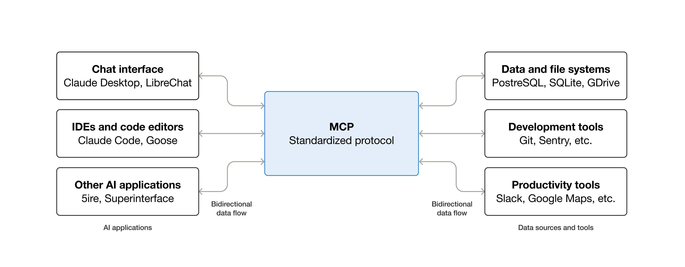
MCP (Model Context Protocol)
An open-source standard for connecting AI applications to external systems.
Notes:
MCP – Model context protocol:
An open source standard for connecting AI apps to external systems
An open protocol that standardizes how applications provide context to LLMs
Raise of hands – who has heard of MCP or used MCP ?
Designed by anthropic late 2024, as a new standard to connect LLM to data. It has evolved quite rapidly and gained traction in the industry. Changes happen frequently and if you are at all interested in adopting you have to be aware that things are still in flux.
Origin: MCP was developed by Anthropic and open-sourced in late 2024. It rapidly gained attention as a vendor-neutral way to connect AI models to external data and functions.
Purpose: MCP acts as a “universal toolbelt” for AI agents. It provides a standard interface for agents (LLMs) to discover and invoke tools or retrieve data. In simpler terms, MCP is like a menu or catalog of what an agent can do beyond just chatting.
Like USB-C but for AI

Slide 9
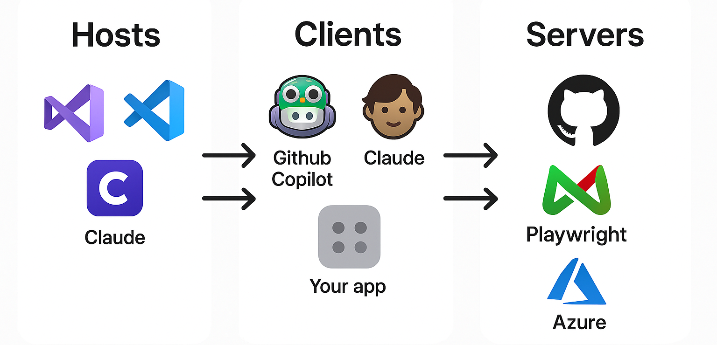
Components
Notes:
HOSTS
Development environments and applications that orchestrate MCP connections
MCP follows a client-server architecture where an MCP host — an AI application like Claude Code or Claude Desktop — establishes connections to one or more MCP servers
CLIENTS The MCP host accomplishes this by creating one MCP client for each MCP server. Each MCP client maintains a dedicated one-to-one connection with its corresponding server
Handle connection management, capability discovery, request forwarding, and response handling according to the MCP spec
SERVERS
Data sources and services that provide context and capabilities via MCP protocol. This is what most people will be building – so this is where we will focus our talk.
- API for LLM
- MCP is to LLMs what SDKs are to developers
Sometimes, Host and Client are the same application – vs code hosts github copilot which is the client MCP enables GitHub Copilot to access external tools and data sources, making your coding assistant more powerful and context-aware

Slide 10
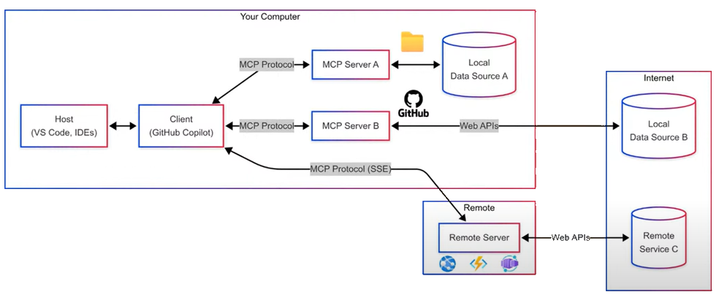
How it works together
Notes:
SSE is now the legacy protocol – preferred protocol is Streamable HTTP.
P.s. copilot studio removed support for SSE in Aug 2025.
Use case 1 - Locally deployed servers
These servers run locally to your agent. The protocol defines a spec of communicating via standard input / output (basically your console outputs). This is useful for development tasks, or other applications that run on your machine and have agents in them. The advantages here is that because the MCP server runs locally, the auth is simple, you can auth to the tool locally – or in some cases it reuses your environment credentials. Some of the more popular servers : Azure MCP and GitHub MCP run in this mode.
The installation of these agents has been simplified to use extensions or deployment mechanisms transparent to the user. It basically deploys the MCP server locally and uses the Client configuration (copilot) to run said agent either with npx, docker, or dotnet commands. The disadvantage is that you have to run this locally so you can’t use it in web-based agents.
Use case 2 – Remote servers
- The servers run online, as a web service. The protocol defines the spec for communicating over HTTP – using Streamable HTTP (and previously SSE). This opens the questions for how do you authenticate, but the spec was recently updated to cover this. This can be a talk in itself so we won’t touch too much on the auth of remote MCP. Hosting servers remotely can be done in any technology – functions, web apps, container apps, exposed though APIm, Api center, etc. This is required if you want to create online agents. Note that SSE (Server Side Events) was recently deprecated in favor of Streamable HTTP.

Slide 11
How it works together
Notes:
SSE is now the legacy protocol – preferred protocol is Streamable HTTP.
P.s. copilot studio removed support for SSE in Aug 2025.
Use case 1 - Locally deployed servers
These servers run locally to your agent. The protocol defines a spec of communicating via standard input / output (basically your console outputs). This is useful for development tasks, or other applications that run on your machine and have agents in them. The advantages here is that because the MCP server runs locally, the auth is simple, you can auth to the tool locally – or in some cases it reuses your environment credentials. Some of the more popular servers : Azure MCP and GitHub MCP run in this mode.
The installation of these agents has been simplified to use extensions or deployment mechanisms transparent to the user. It basically deplys the MCP server locally and uses the Client configuration (copilot) to run said agent either with npx, docker, or dotnet commands. The disadvantage is that you have to run this locally so you can’t use it in web-based agents.
Use case 2 – Remote servers
- The servers run online, as a web service. The protocol defines the spec for communicating over HTTP – using Streamable HTTP (and previously SSE). This opens the questions for how do you authenticate, but the spec was recently updated to cover this. This can be a talk in itself so we won’t touch too much on the auth of remote MCP. Hosting servers remotely can be done in any technology – functions, web apps, container apps, exposed though APIm, Api center, etc. This is required if you want to create online agents. Note that SSE (Server Side Events) was recently deprecated in favor of Streamable HTTP.

Slide 12
How it works together
Notes:
SSE is now the legacy protocol – preferred protocol is Streamable HTTP.
P.s. copilot studio removed support for SSE in Aug 2025.
Use case 1 - Locally deployed servers
These servers run locally to your agent. The protocol defines a spec of communicating via standard input / output (basically your console outputs). This is useful for development tasks, or other applications that run on your machine and have agents in them. The advantages here is that because the MCP server runs locally, the auth is simple, you can auth to the tool locally – or in some cases it reuses your environment credentials. Some of the more popular servers : Azure MCP and GitHub MCP run in this mode.
The installation of these agents has been simplified to use extensions or deployment mechanisms transparent to the user. It basically deplys the MCP server locally and uses the Client configuration (copilot) to run said agent either with npx, docker, or dotnet commands. The disadvantage is that you have to run this locally so you can’t use it in web-based agents.
Use case 2 – Remote servers
- The servers run online, as a web service. The protocol defines the spec for communicating over HTTP – using Streamable HTTP (and previously SSE). This opens the questions for how do you authenticate, but the spec was recently updated to cover this. This can be a talk in itself so we won’t touch too much on the auth of remote MCP. Hosting servers remotely can be done in any technology – functions, web apps, container apps, exposed though APIm, Api center, etc. This is required if you want to create online agents. Note that SSE (Server Side Events) was recently deprecated in favor of Streamable HTTP.

Slide 13
MCP Server constructs
Tools
The workhorse of MCP. They enable AI models to perform actions. Each tool defines a specific operation with typed inputs and outputs. The model requests tool execution based on context.
Resources
Passive data sources that provide read-only access to information for context, such as file contents, database schemas, or API documentation.
Prompts
Provide reusable templates. They allow MCP server authors to provide parameterized prompts for a domain, or showcase how to best use the MCP server.
Notes:
Tools
Tools enable AI models to perform actions. Each tool defines a specific operation with typed inputs and outputs. The model requests tool execution based on context.
​
How Tools Work
Tools are schema-defined interfaces that LLMs can invoke. MCP uses JSON Schema for validation. Each tool performs a single operation with clearly defined inputs and outputs. Tools may require user consent prior to execution, helping to ensure users maintain control over actions taken by a model.
--------
Resources
Resources provide structured access to information that the AI application can retrieve and provide to models as context.
​
How Resources Work
Resources expose data from files, APIs, databases, or any other source that an AI needs to understand context. Applications can access this information directly and decide how to use it - whether that’s selecting relevant portions, searching with embeddings, or passing it all to the model. Each resource has a unique URI (like file:///path/to/document.md) and declares its MIME type for appropriate content handling. They declare MIME types for appropriate content handling and support two discovery patterns:
----
Prompts
Prompts provide reusable templates. They allow MCP server authors to provide parameterized prompts for a domain, or showcase how to best use the MCP server.
​
How Prompts Work
Prompts are structured templates that define expected inputs and interaction patterns. They are user-controlled, requiring explicit invocation rather than automatic triggering. Prompts can be context-aware, referencing available resources and tools to create comprehensive workflows. Similar to resources, prompts support parameter completion to help users discover valid argument values.

Slide 14

Demo 1 – MCP in action
Notes:
Script:
Ope VsCode – open Gh – show around copilot
Agent vs ask
Model
Tools!
Embedded tools – extension tools, our own servers
Open VsCode - open ride radar – NO Azure MCP – show the 2 prompts.
Open VsCode Insiders – open ride radar – Azure MCP – show the 2 prompts/

Slide 15
Building an MCP Server
SDK
Notes:
The SDK abstracts away the protocol – I don’t need to worry about any of those details, I just write the code to expose the tools representing the actions or data I want to give the LLM access to.
Th SDK can help with building a client too in case you want to build an MCP connected agent in your app directly rather than relying on a pre-built host +client.

Slide 16
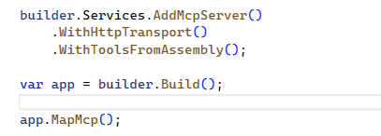
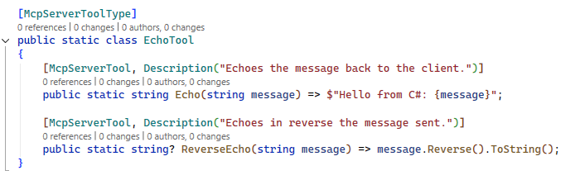

Getting started with the SDK
3 step process:
Install NuGet package(s)
Bootstrap your code
Expose your tools
ModelContextProtocol.Core
ModelContextProtocol
ModelContextProtocol.AspNetCore
Notes:
3 main nuget packages
ModelContextProtocol.Core -> For people who only need to use the client or low-level server APIs and want the minimum number of dependencies. Basic functionality
ModelContextProtocol -> Depends on Core. The main package with hosting and dependency injection extensions. This is the right fit for most projects that don't need HTTP server capabilities.
ModelContextProtocol.AspNetCore -> for remote servers over htpp sse and streamable http

Slide 17
MCP Inspector
npm instal -g @modelcontextprotocol/inspector

Slide 18

Demo 2 – Ride Radar MCP
Notes:
In Vs code:
#get_all_makes what cars do we have in the database
awesome . what are the trims available for the Toyota corolla
show me the details for the LE CVT trim please
what is the difference between LE CVT and SE CVT ?

Slide 19

Demo 3 – Building an Agent

